Slide 1

Predicting and analyzing Crime in Pittsburgh
Team F - Kedar Dabhadkar, Reshma Gajula, Rohit Tawde

Slide 2
Objectives
Find correlations between various social factors (census data) and crime rate- Census data.
Predict the crime rate using a time series model conditioned on location - Police blotter data.
Data
Police Blotter Archive- City of Pittsburgh
Data about all arrests in Pittsburgh from 2005 to 2015.
The data is organized by incident time, location, type of offence among others.
Census data for the years 2011 and 2015
Property Value
Educational Attainment
Race

Slide 3
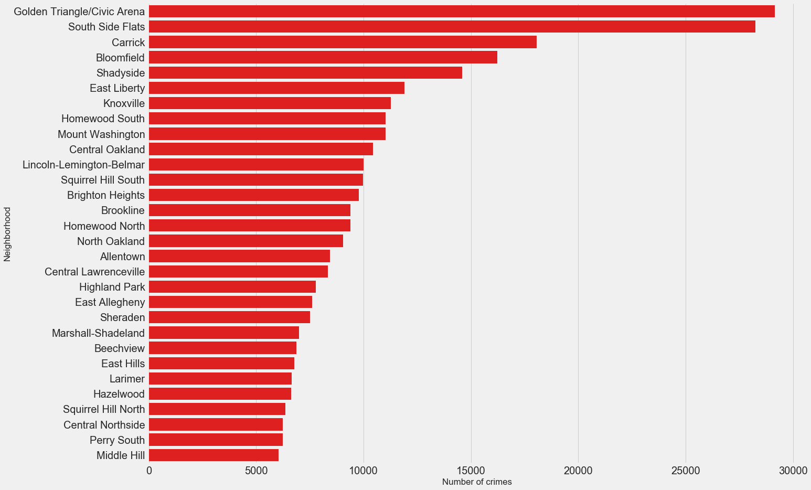
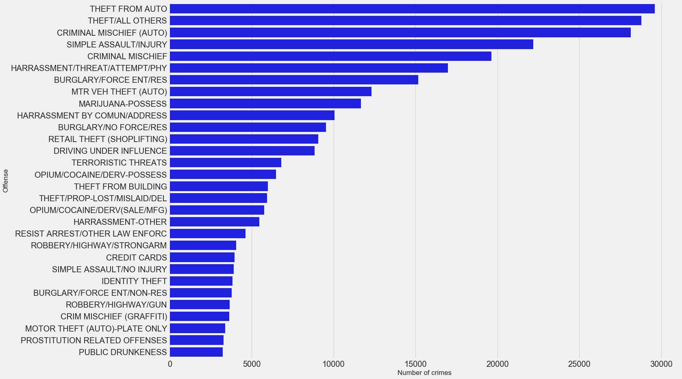
Part 1: Descriptive
Census data from United Census Bureau until 2016
Grouped data by:
Neighborhood
Offense

Slide 4
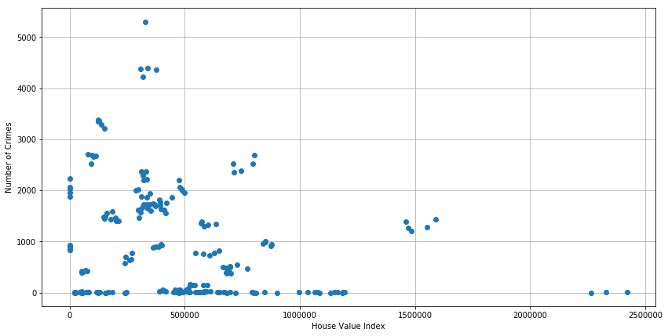
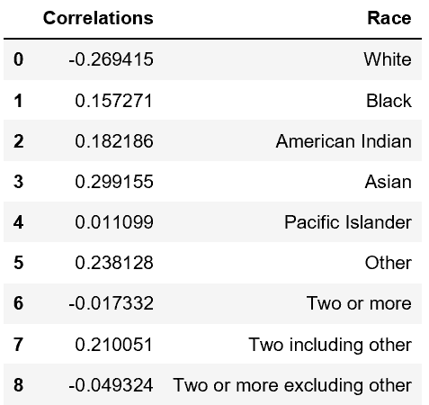
Establishing Correlations
Socio - Economic Factors affect crime density
Pearson Correlation = -0.21

Slide 5
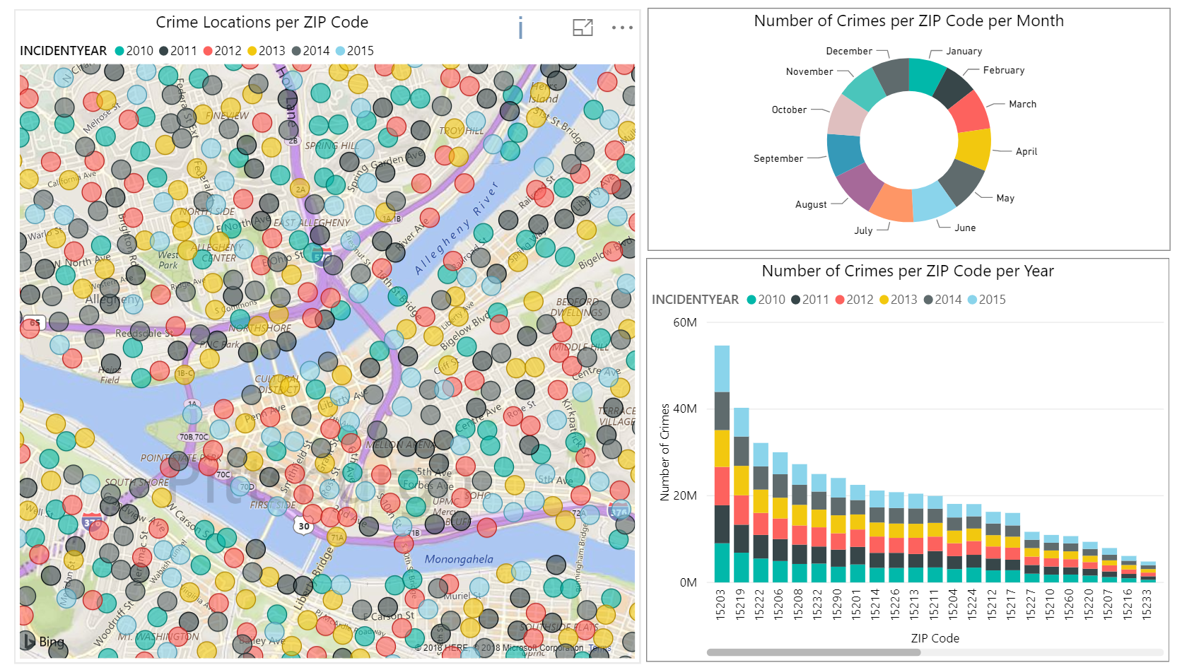
Static Dashboard

Slide 6
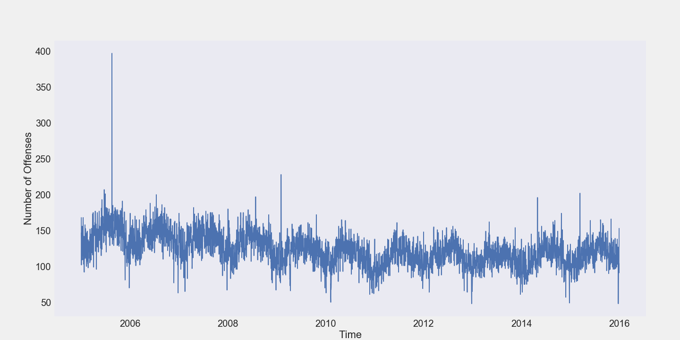
Time Series

Slide 7
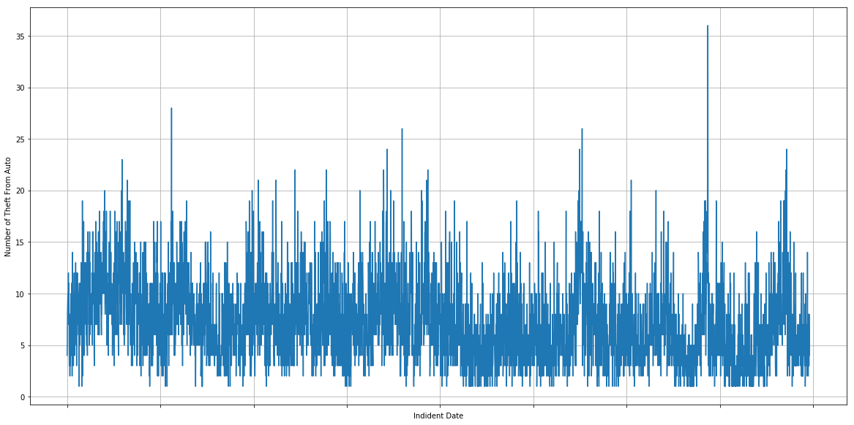
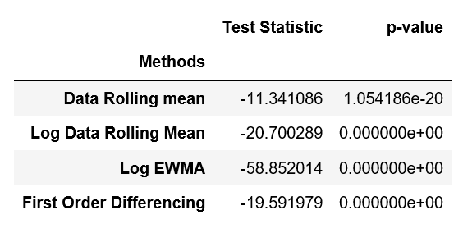
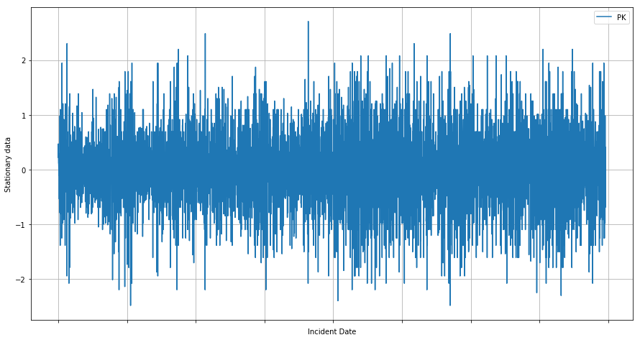
Inducing Stationarity
Mean = 7.2400
Std = 3.7991
Number of Thefts From Auto
Mean = 0.0001
Std = 0.7412
Stationary values
Incident Date

Slide 8
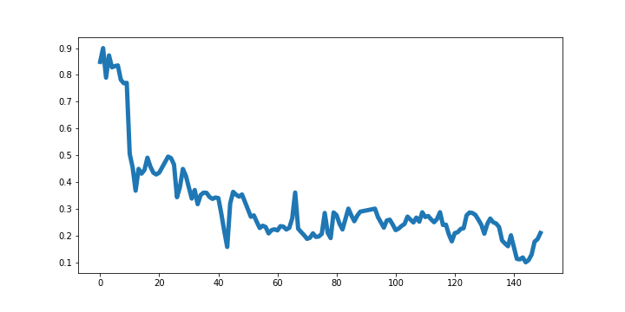
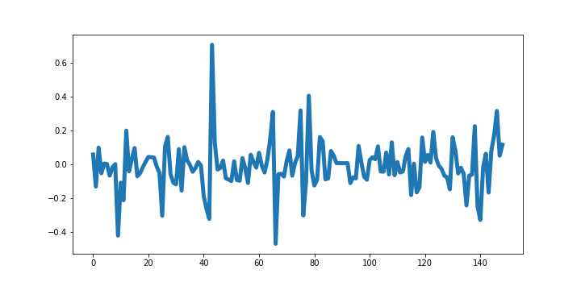
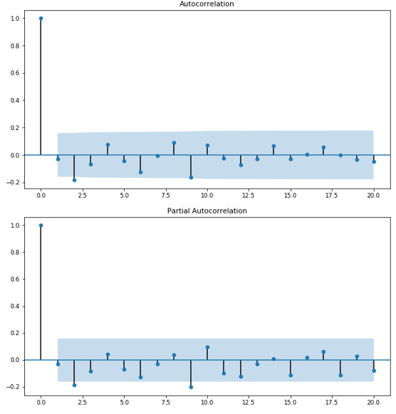
Preprocessing
Raw data
Stationarity is necessary for:
Time invariant statistical properties like mean, variance.
Reducing correlations among lags, resulting in lesser computations.
Steps in preprocessing:
Scaling between 0.1 and 0.9,
Logarithmic transform, and,
First order differencing to induce stationarity.
Autorrelations orders are found from autocorrelation function (ACF) and partial autocorrelation function (PACF).
Temperature
Time
Stationary data
Stationary Temperature
Time
Autocorrelation function
Correlations
Lags

Slide 9
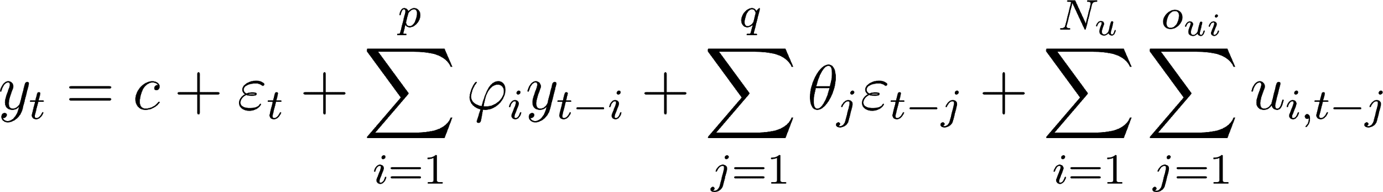



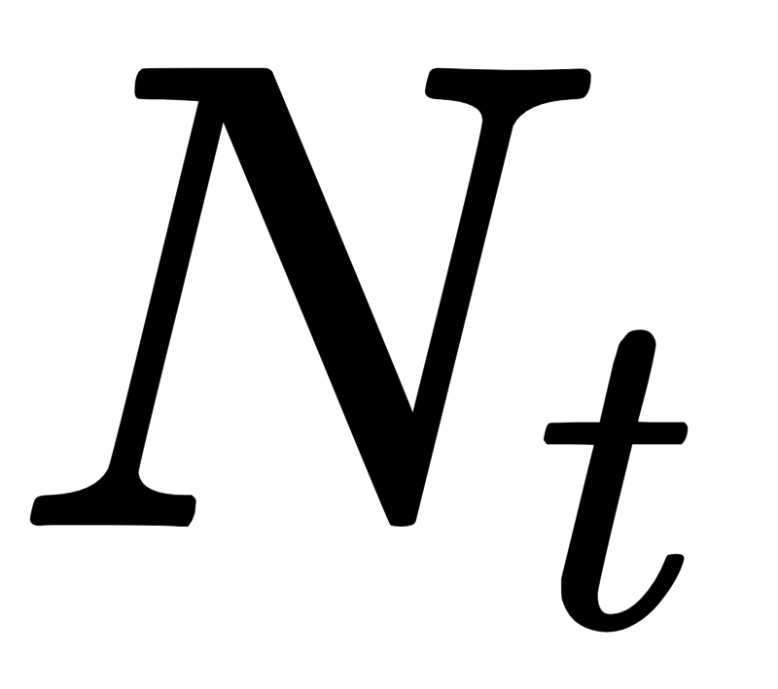

Autoregressive Moving Average (ARIMA)
ω_{ij}
Autoregressive
Moving Average
Recurrent with respect to exogenous parameters
: Value of variable at time t
θ,𝜑 : Parameters
: white noise with zero mean and a fixed variance
: Value of exogenous parameter u_{i} at time t.
: Number of exogenous parameters.
: Order with respect to u_{i}.

Slide 10
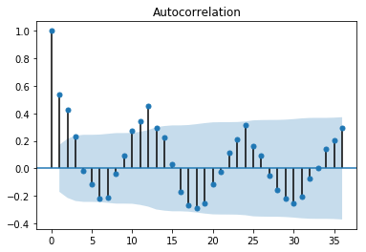
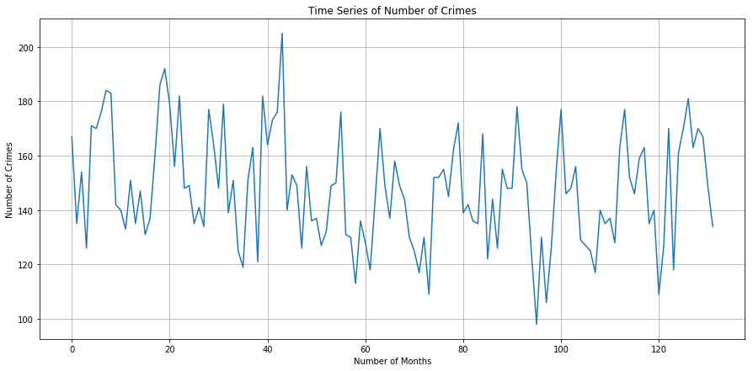
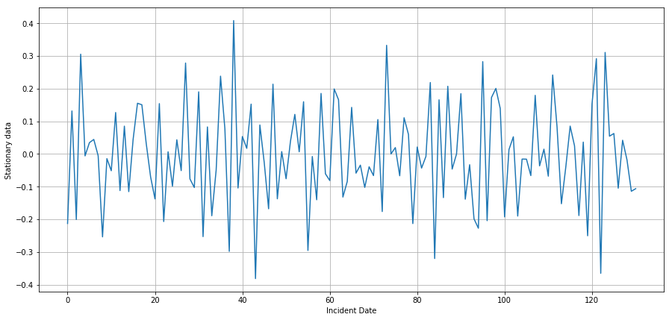
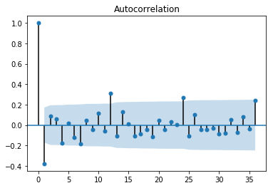
Identifying AR & MA
Mean = 147.5
Std = 20.41
Number of Crimes
Mean = -0.001
Std = 0.15
Stationary values
Number of Months

Slide 11
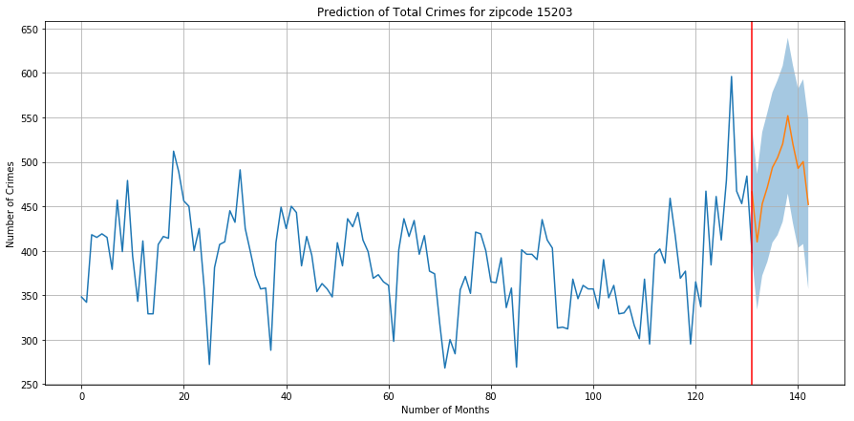
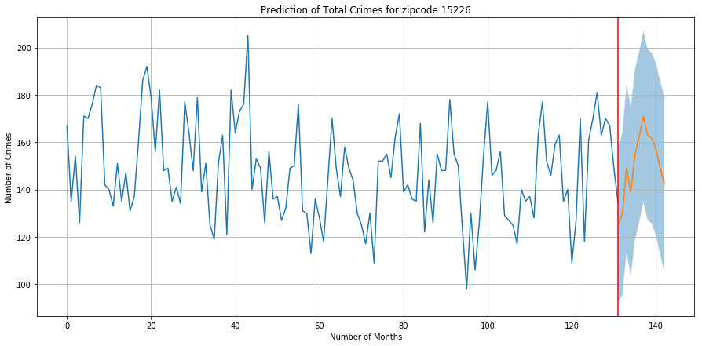
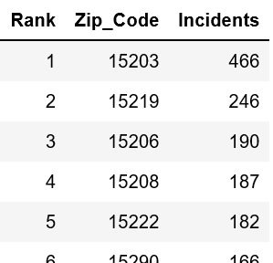
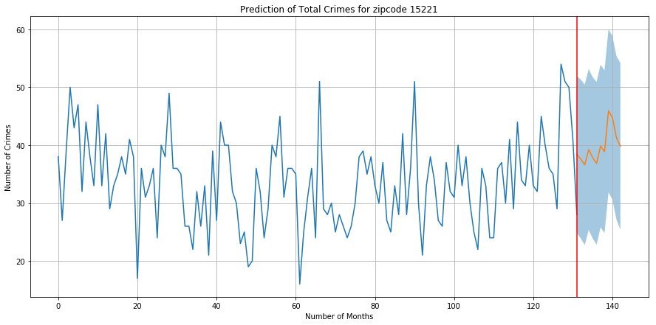
Time Series Prediction
15203
15226
15221

Slide 12
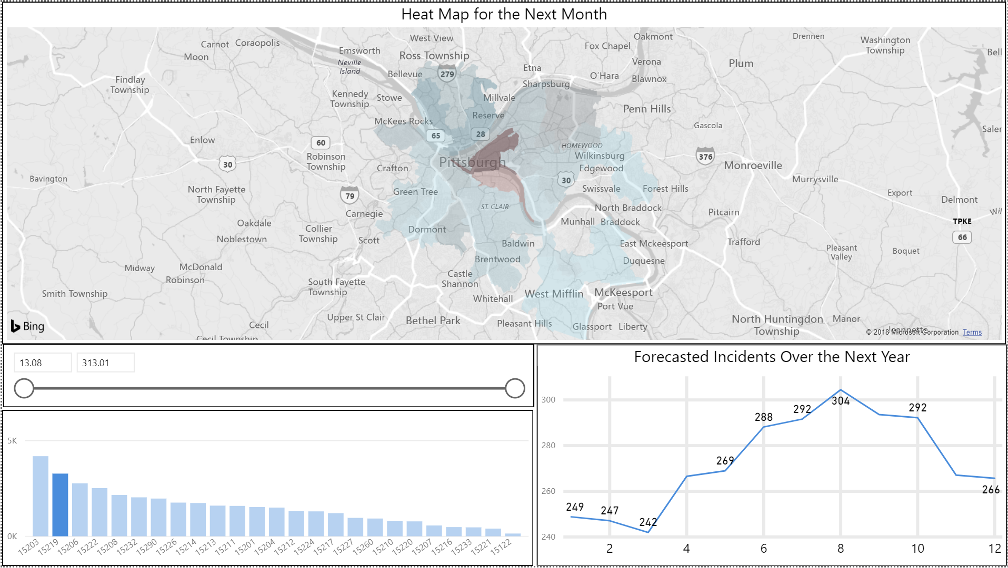
Interactive Dashboard

Slide 13
Risk and Mitigation Strategies
Absence of incidents not reported
Assumed that all incidents are reported
Missing location data
Filled with mean or median values of locations of neighborhood in which that crime occured
Correlations might not translate to causation
Validating with similar samples but differing in only one attribute where hypothesis needs to be tested (A/B Testing)

Slide 14
Future Work
Part 1:
Compiling the results of influence of all social factors on the number of crimes
Part 2:
Try to use non-linear methods to make future predictions
Dashboard:
Try to link the dashboard directly to the Jupyter notebook to provide instantaneous visualizations

Slide 15
Thank you!

